Slide 1
Gaming Input and the Arcade
Donald Heer
2/14/2011

Slide 2
Overview
Input Types
Keyboard
Mouse
Examples
The Arcade
What inputs does the arcade have?

Slide 3
Inputs in General
Input is an Event
Event: an action that is usually initiated outside the scope of a program
Asynchronous
Should be ‘caught’ and buffered

Slide 4
Simple Directmedia Layer (SDL)
SDL is a ‘wrapper’ that allows for use of many standard function in a way that is easier for producing games
SDL contains input and output functions including mouse, keyboard, sound, and video.
SDL is compatible with OpenGL

Slide 5
Sample Program
The sample program we will be using is:
Based on NeHe source (Lesson 3)
Controls the rotation of a cube based on mouse and keyboard input.

Slide 6
Keyboard Events
bool Lesson::processEvents(){
SDL_Event event;
while (SDL_PollEvent(&event)){
switch (event.type) case{
case SDL_KEYDOWN:{
SDLKey sym = event.key.keysym.sym;

Slide 7
Mouse Events
bool Lesson::processEvents(){
SDL_Event event;
while (SDL_PollEvent(&event)){
switch (event.type) case{
case SDL_MOUSEBUTTONDOWN:{
std::cout << "Mouse Button Pressed.";
if( event.button.button == SDL_BUTTON_LEFT )

Slide 8
Example
Lets look at the sample code.

Slide 9
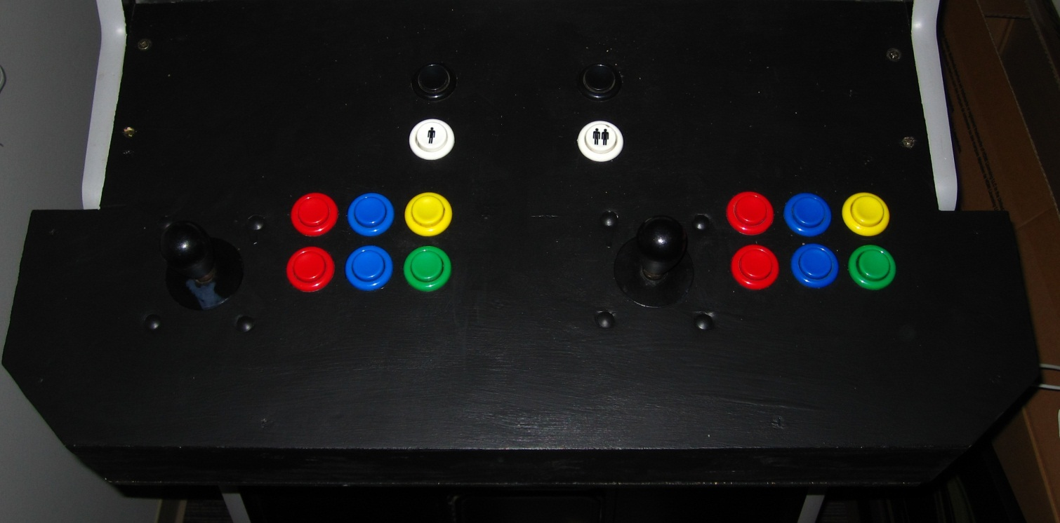
The Arcade
2 player Support
Acts as a Keyboard
Currently setup for ‘free play’

Slide 10
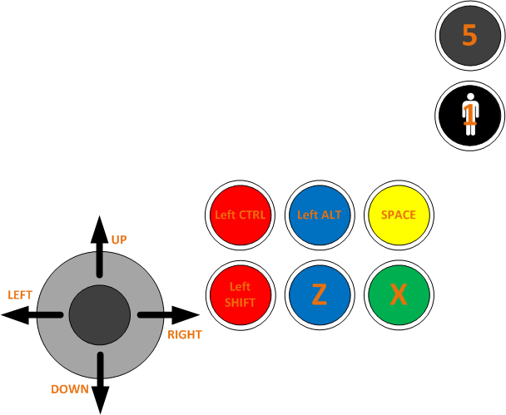
Player 1 Controls
‘Add Credit’ button is ‘5’
Limit your program to no more than 8 buttons at once
http://www.ultimarc.com/ipac2.html

Slide 11
Arcade Gotchas
Make sure to check for all buttons, not just the ‘first button’

Slide 12
Summary
Input must be captured and processed when time is available
Special abilities (click and hold) need to be hand made in many cases

Slide 13
Questions?

